Slide 1
2024
SUFFOLK COUNTY CONTRACT PROCESS
OMNIBUS AWARD
ANNETTE BROWNELL

Slide 2
Purpose of Grants is to support the mission of the Department of Economic Development in the area of Cultural Tourism and Film
OUR MISSION
Supporting community arts organizations, including collectives, that embody high artistry, artistic vibrancy and foster cultural participation in order to build vibrant communities, amplify the voice of underrepresented communities, and celebrate the diversity of Suffolk County.

Slide 3
WHERE DOES THE FUNDING COME FROM?
Fund 192
Hotel / Motel Tax
Section §327-14 of the Suffolk County Code: 10% of all revenues collected shall be utilized by the County of Suffolk in support of CULTURAL PROGRAMS and activities relevant to the continuation and enhancement of the tourism industry, and not more than 5.5% of all revenues collected shall be utilized for the promotion of Suffolk County as a FILM-FRIENDLY location.
Requires that these funds be directed to “cultural programs and activities relevant to the enhancement of the tourism industry.” Cultural programs and activities are defined as programs of any and all cultural disciplines, which include but are not limited to: music, dance, theatre, creative writing, literature, architecture, painting, sculpture, folk arts, photography, video and film, public media, history, museums; and the execution and promotion of other allied major cultural forms.

Slide 4
Background
Funding approved through adoption of EDP’s Operating Budget.
Program has grown 270% in last 10 years.
In 2014 EDP administered $776,340 to 56 organizations.
For 2024:
> Budget is approximately $2.5 million
> 172 organizations, 46 of them are new organizations
Approximately 30% of organizations experience some difficulty in receiving their full grant award due to:
> ineligible projects
> missing paperwork
> insufficient documentation of expenses
> failure to file financial disclosure form with Comptroller’s Office prior to Sept 15th

Slide 5
Pre-Contract Checklist
IRS Determination Letter (Non-Profit Status)
Mailing Address
Physical Address
Contact Name
Signatory Name
Phone Number
E-mail address
Voided Check
Electronic Funds Transfer (EFT) Form
Certificate of Insurance
Completed W-9

Slide 6
REQUIRED DOCUMENTS

Slide 7
DOCUMENTS REQUIRED IMMEDIATELY
Project Summary
This is a narrative explanation. Just the facts of the project. Organization mission statements are not required.
Project due date is March 31, 2024 – must be typed.
Explanation of Budget
This is a financial explanation that tells the County how you will be using the funds.
Please remember:
Street address is required, P.O. Box addresses will be rejected.
Do not include attachments.
Include the date, location and time of the event(s). Please use separate page if needed.

Slide 8
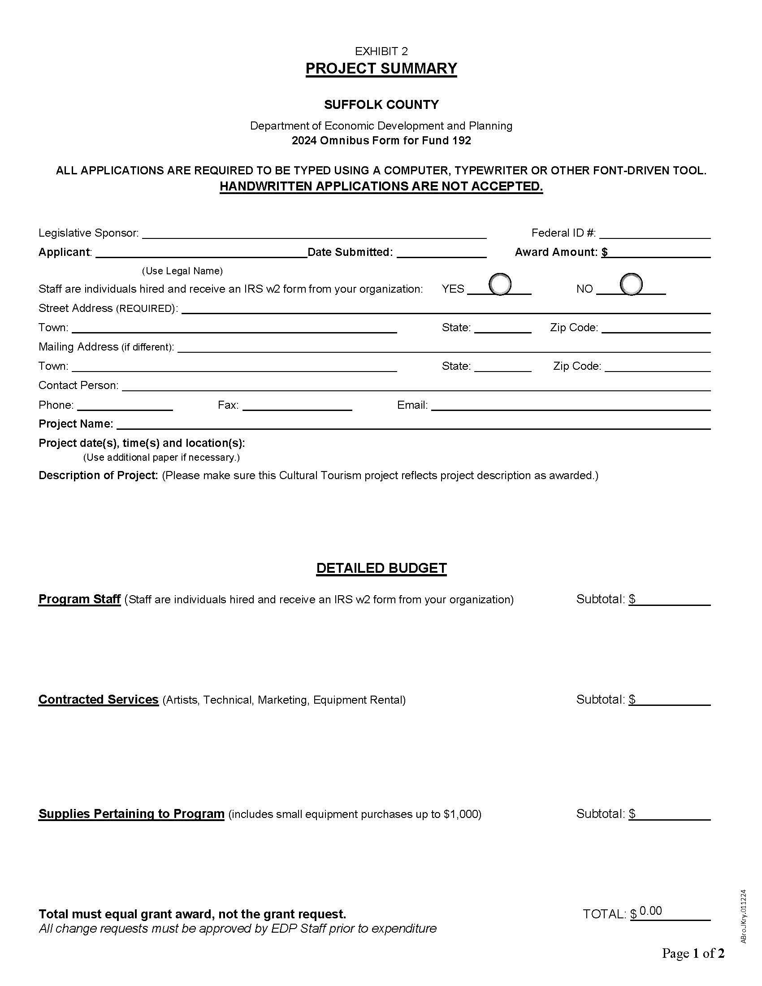

Slide 9
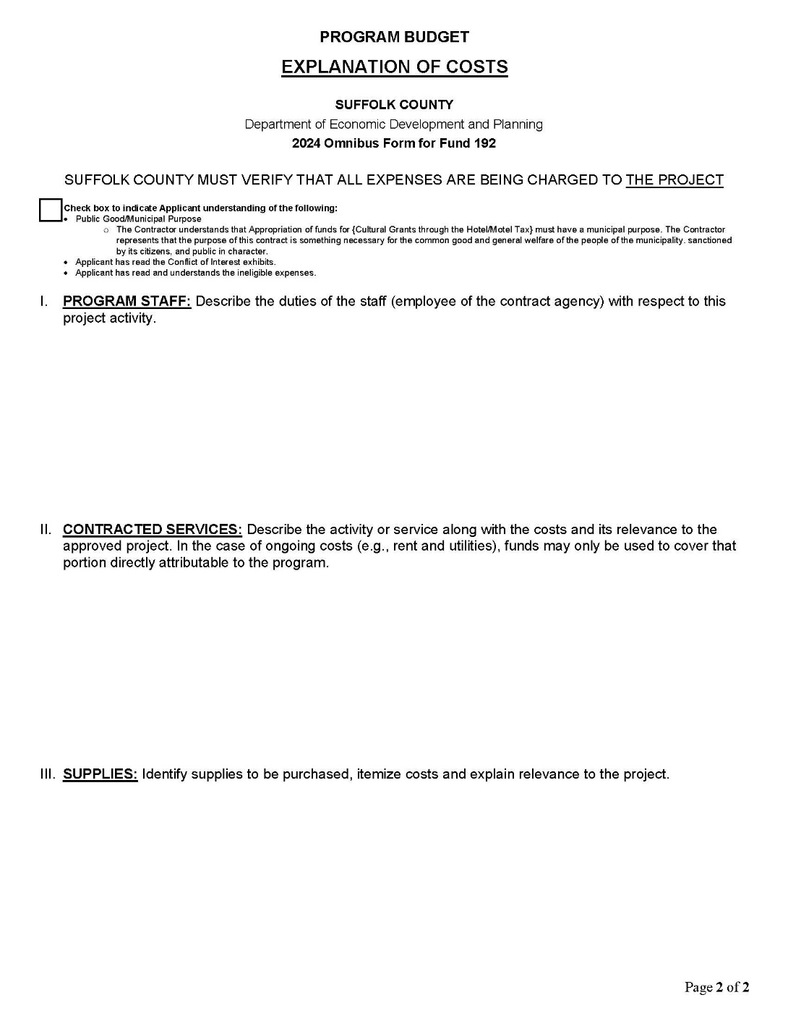

Slide 10
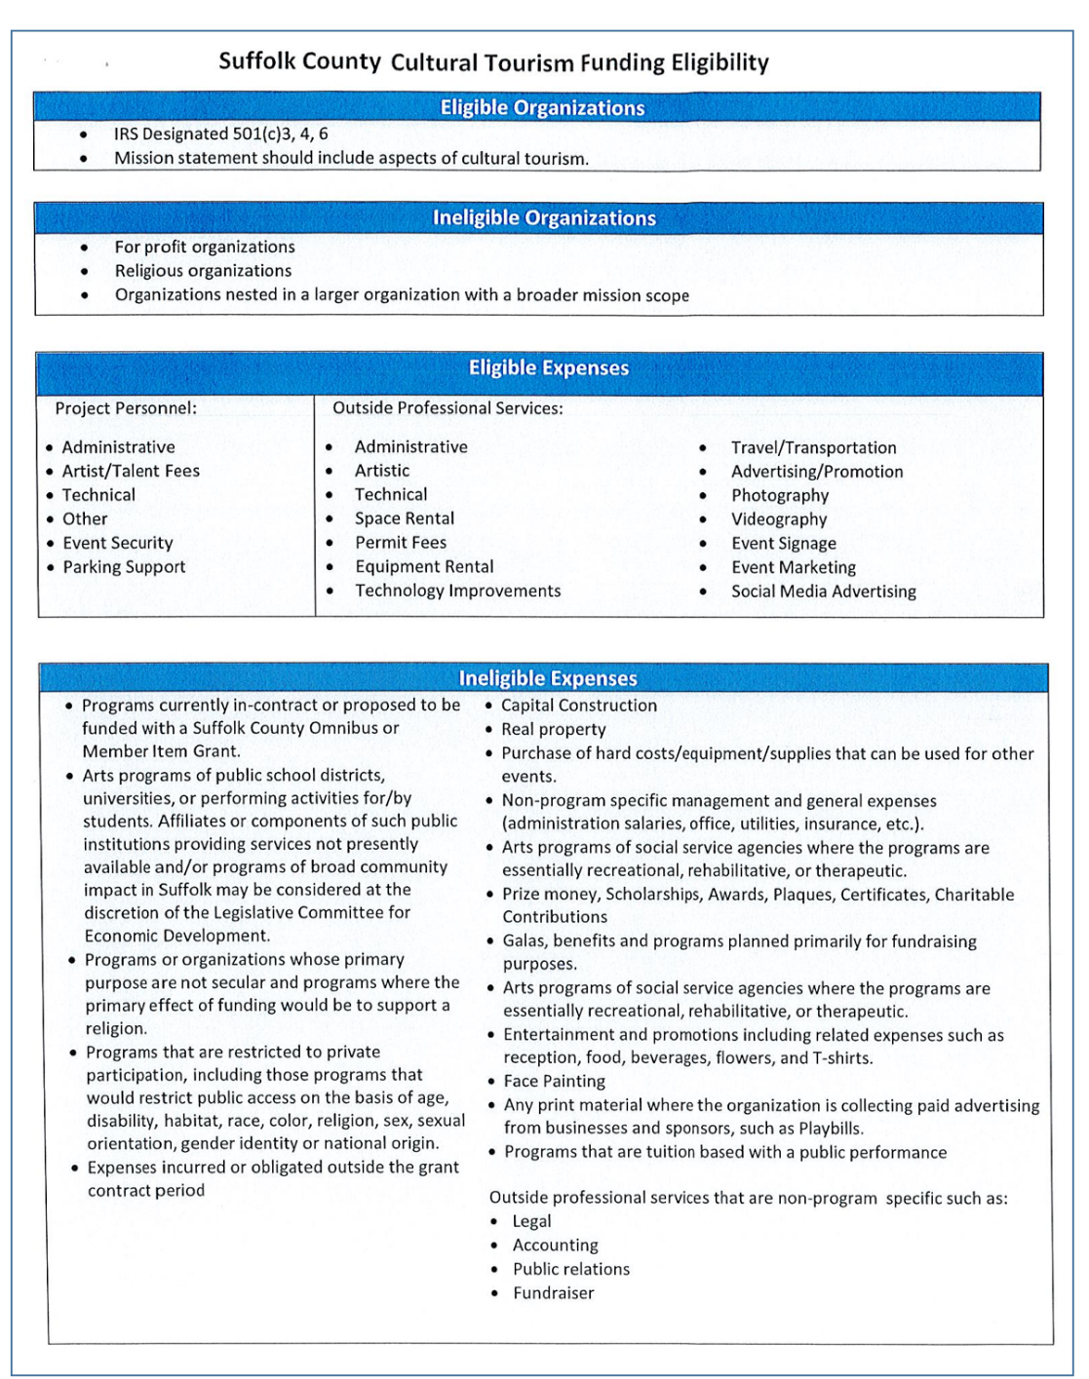

Slide 11
PLEASE SIGN:
Contract Signature Pages with Public
Disclosure Statement
Statement of Other Contracts
Living Wage/Lawful Hiring Forms
Union Organizing Certification – 2 pages
Suffolk County Payment Voucher

Slide 12
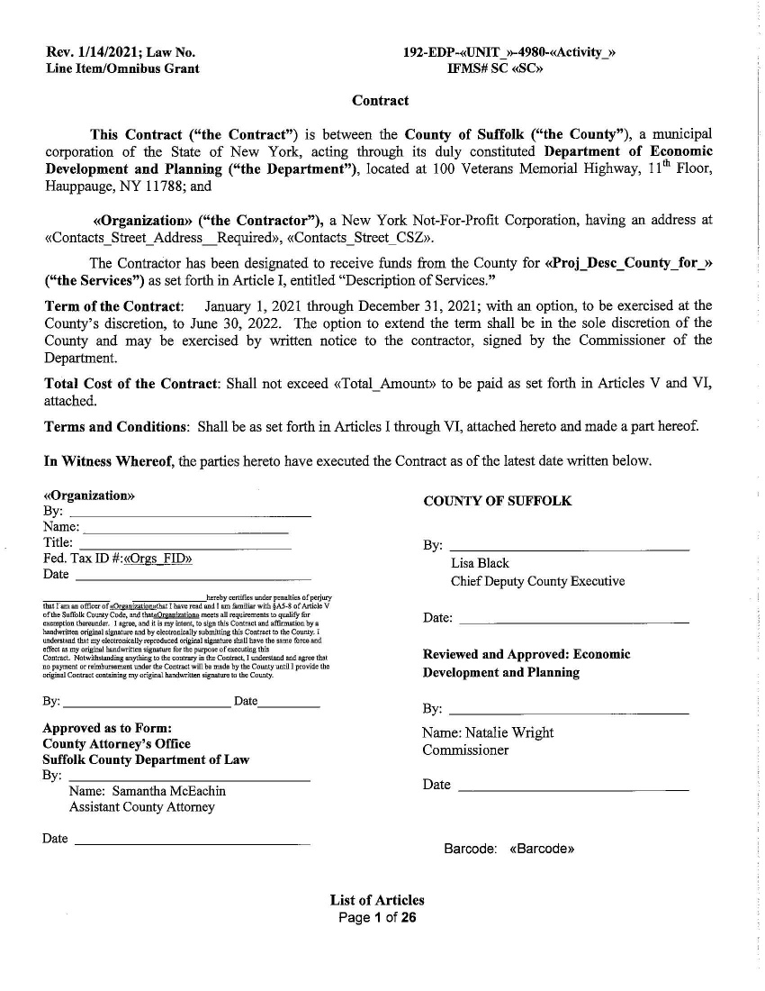
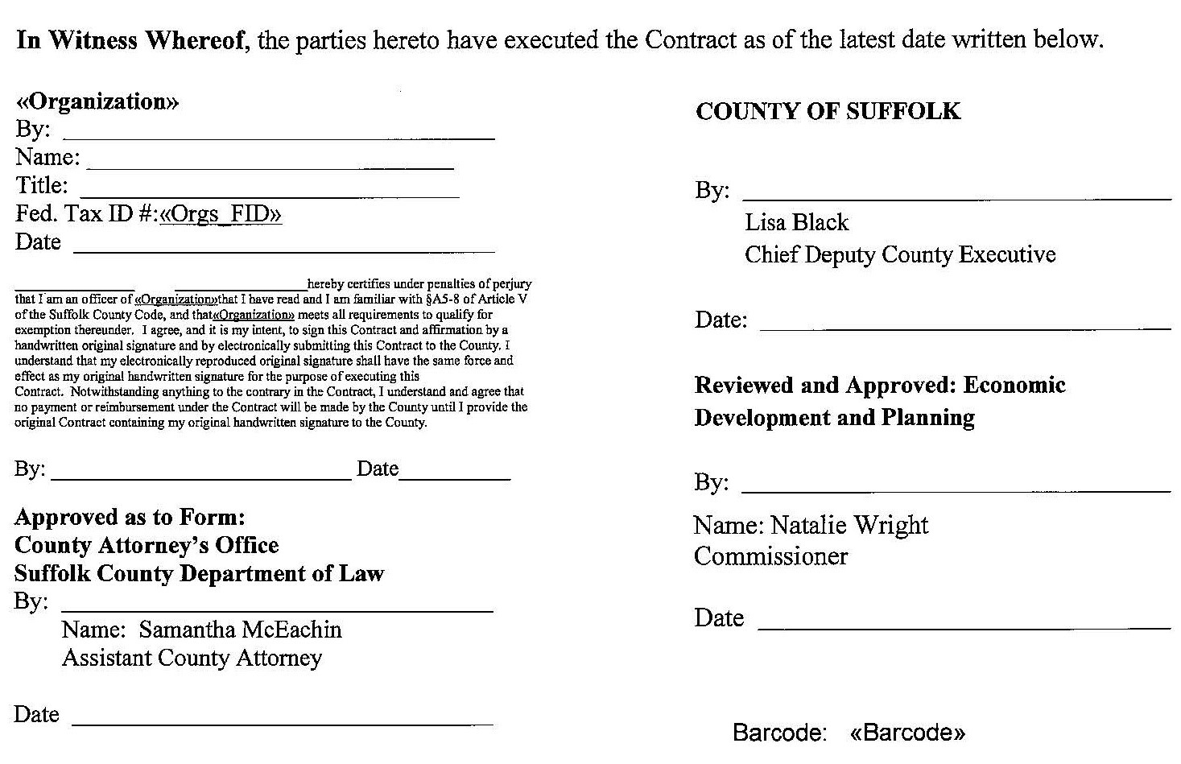
Name: Sarah Lansdale
Commissioner

Slide 13
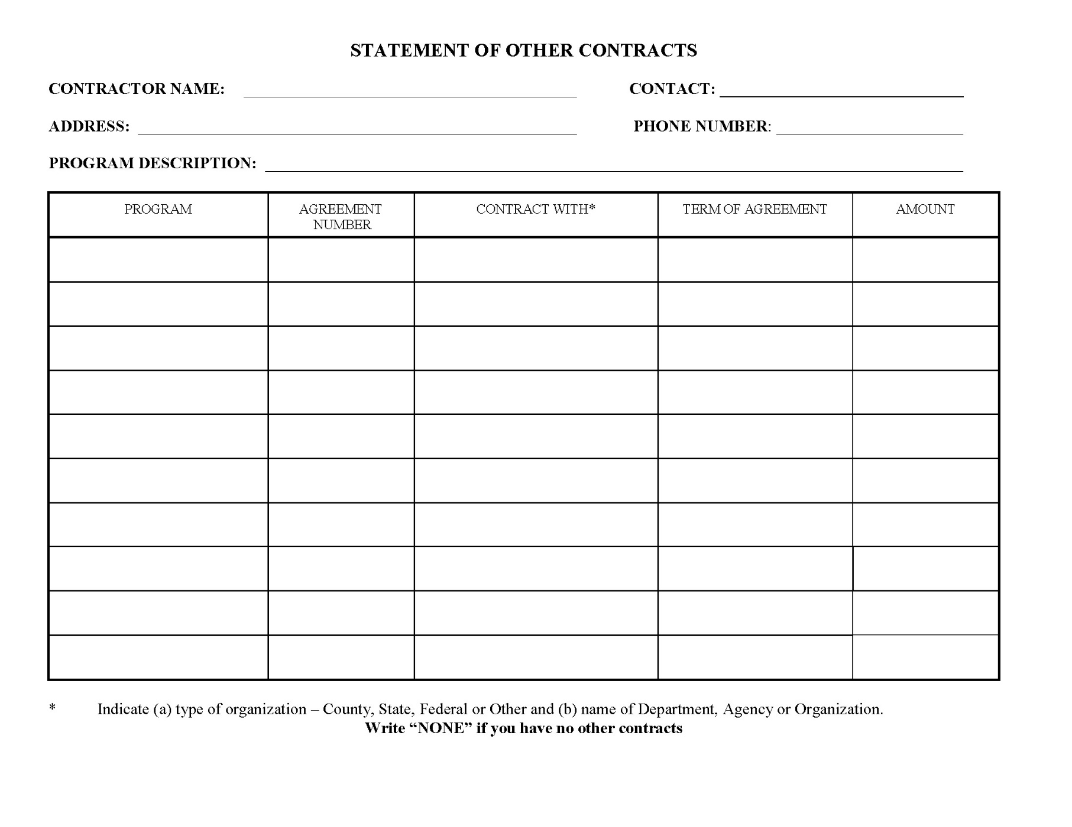

Slide 14
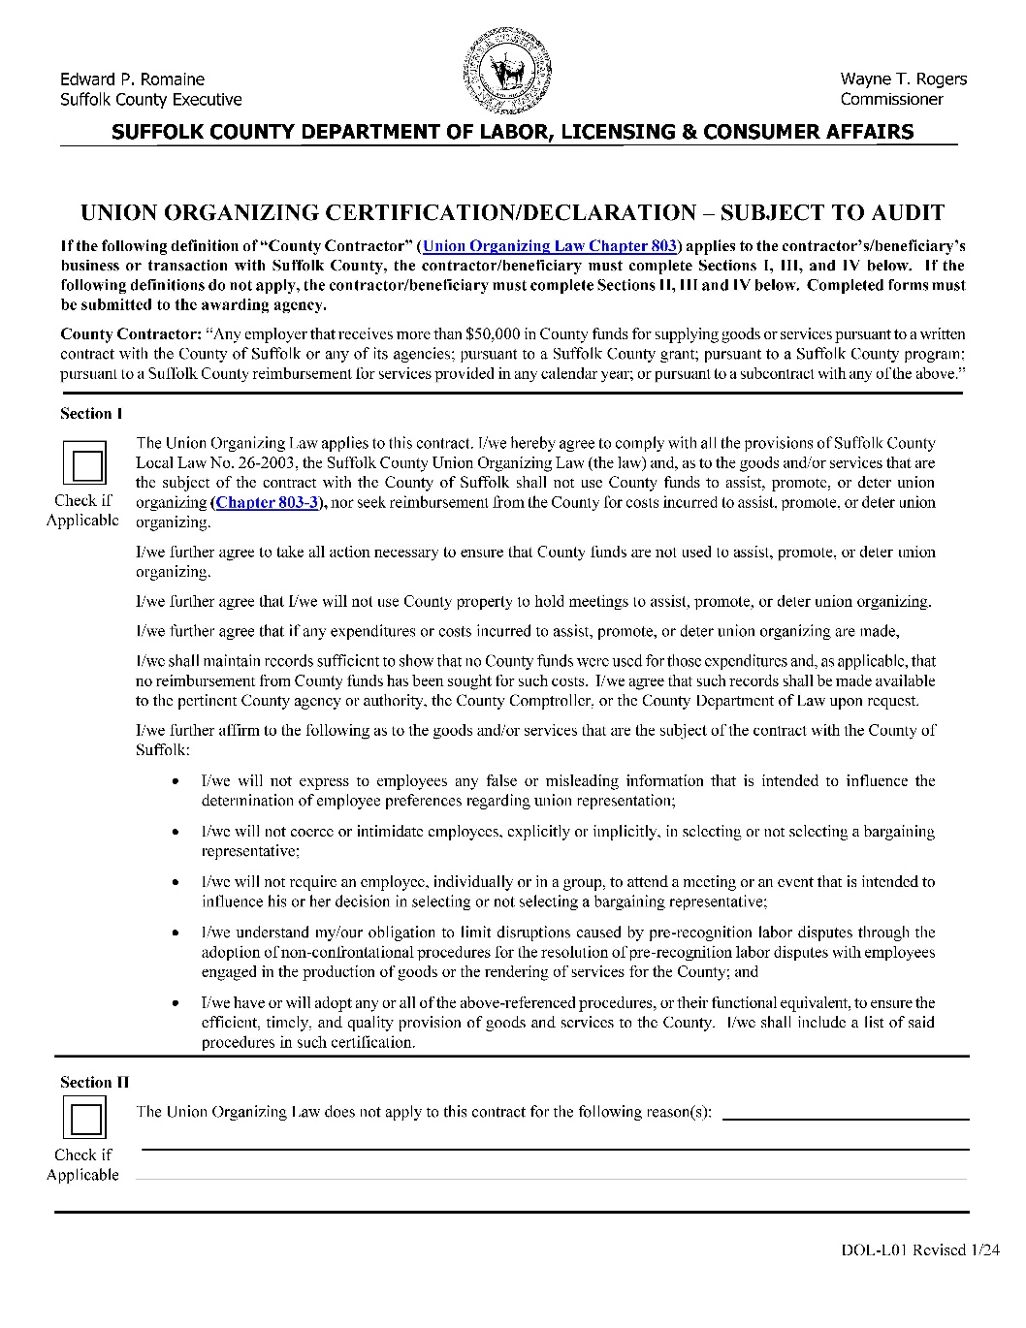
Notes:
Union Organizing Declaration

Slide 15
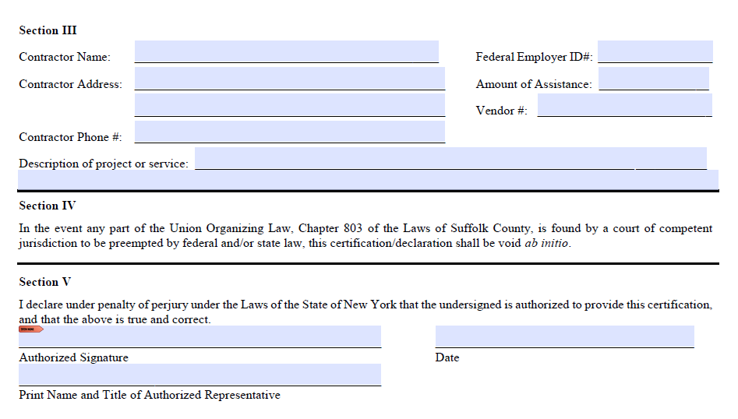

Slide 16
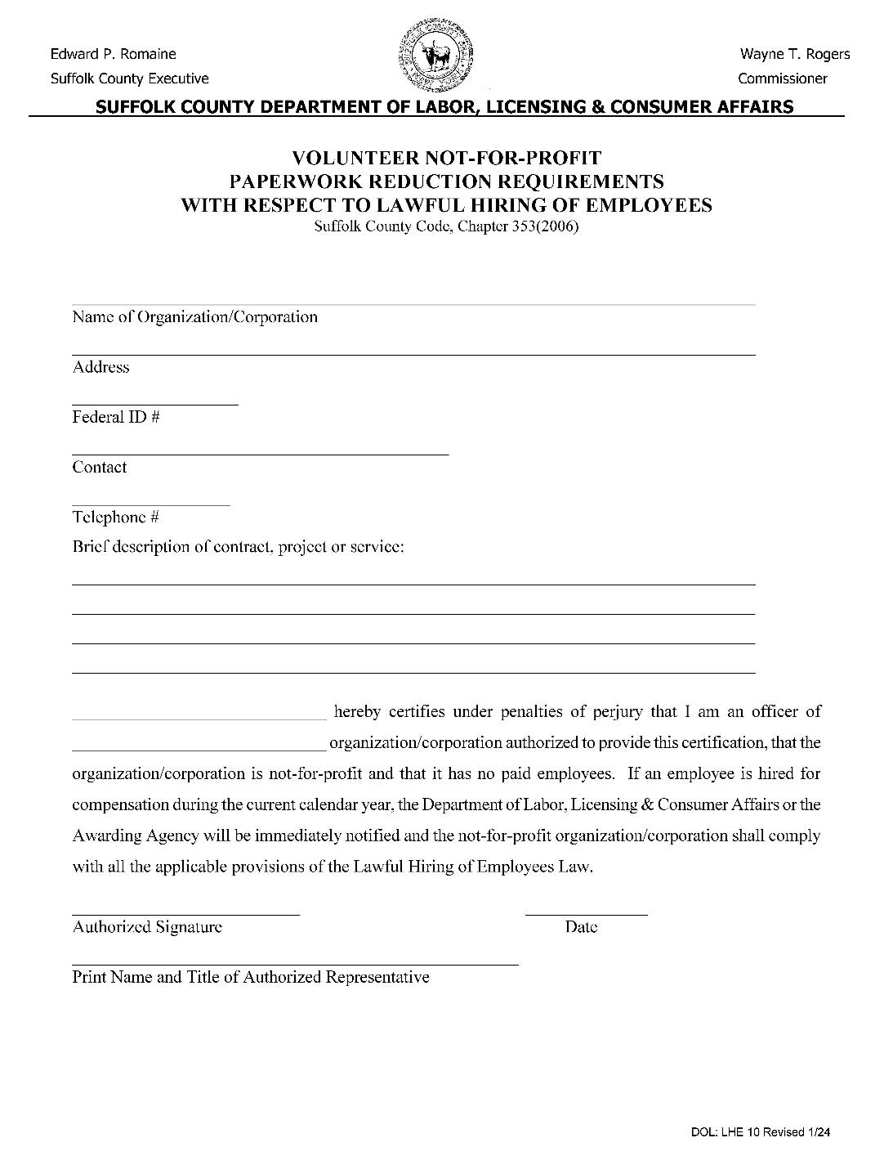
Notes:
Lawful Hiring of Employees/Zero Employees

Slide 17
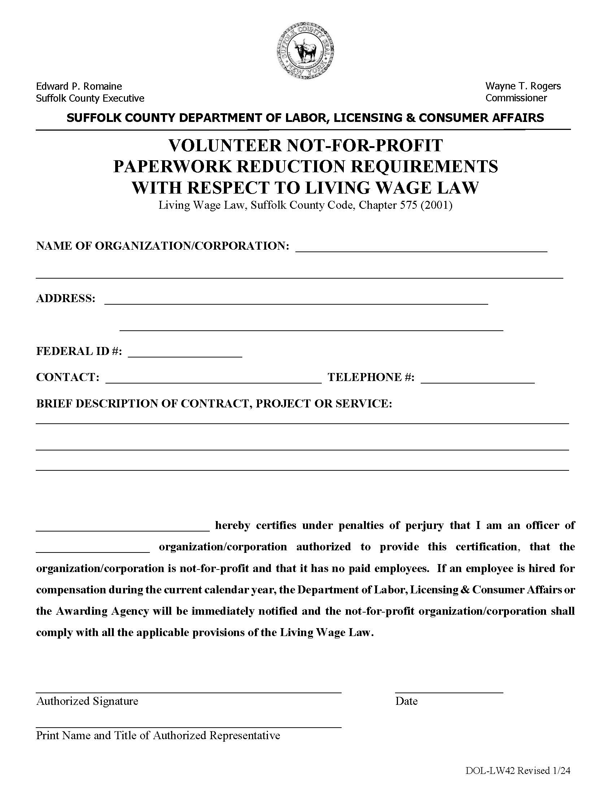
Notes:
Living wage Form/Zero Employees

Slide 18
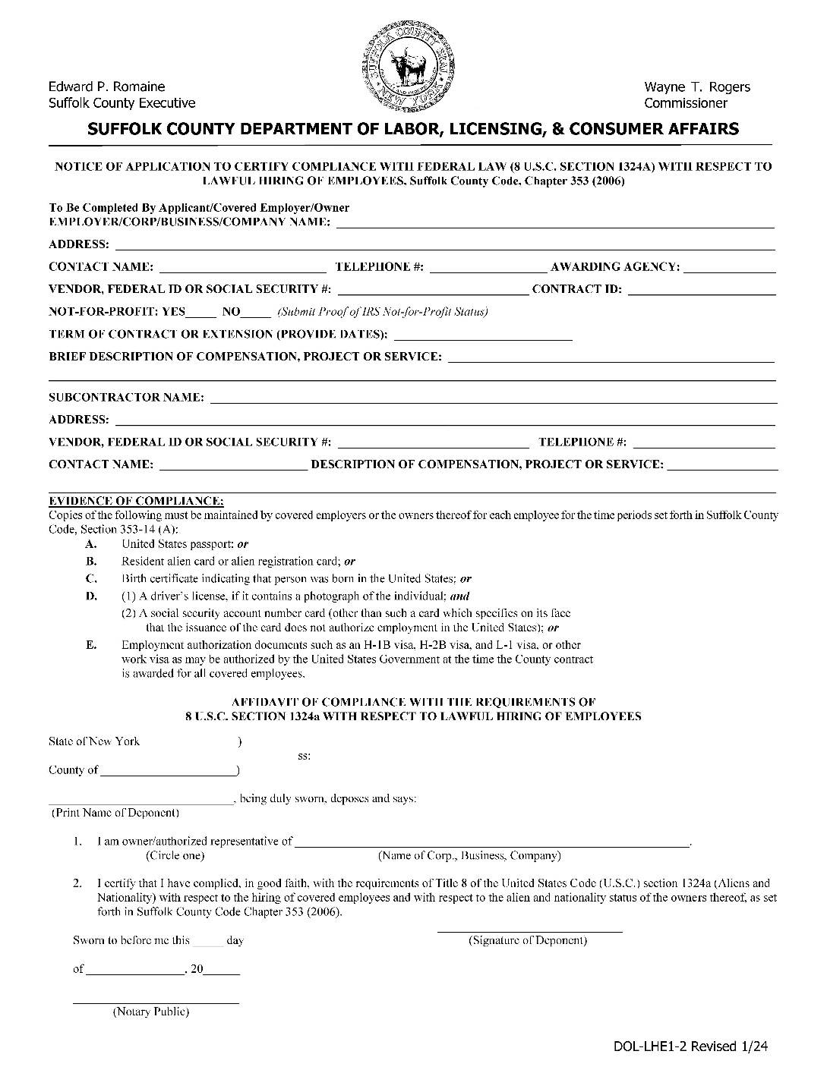
Notes:
Lawful Hiring of Employees/Has Employees

Slide 19
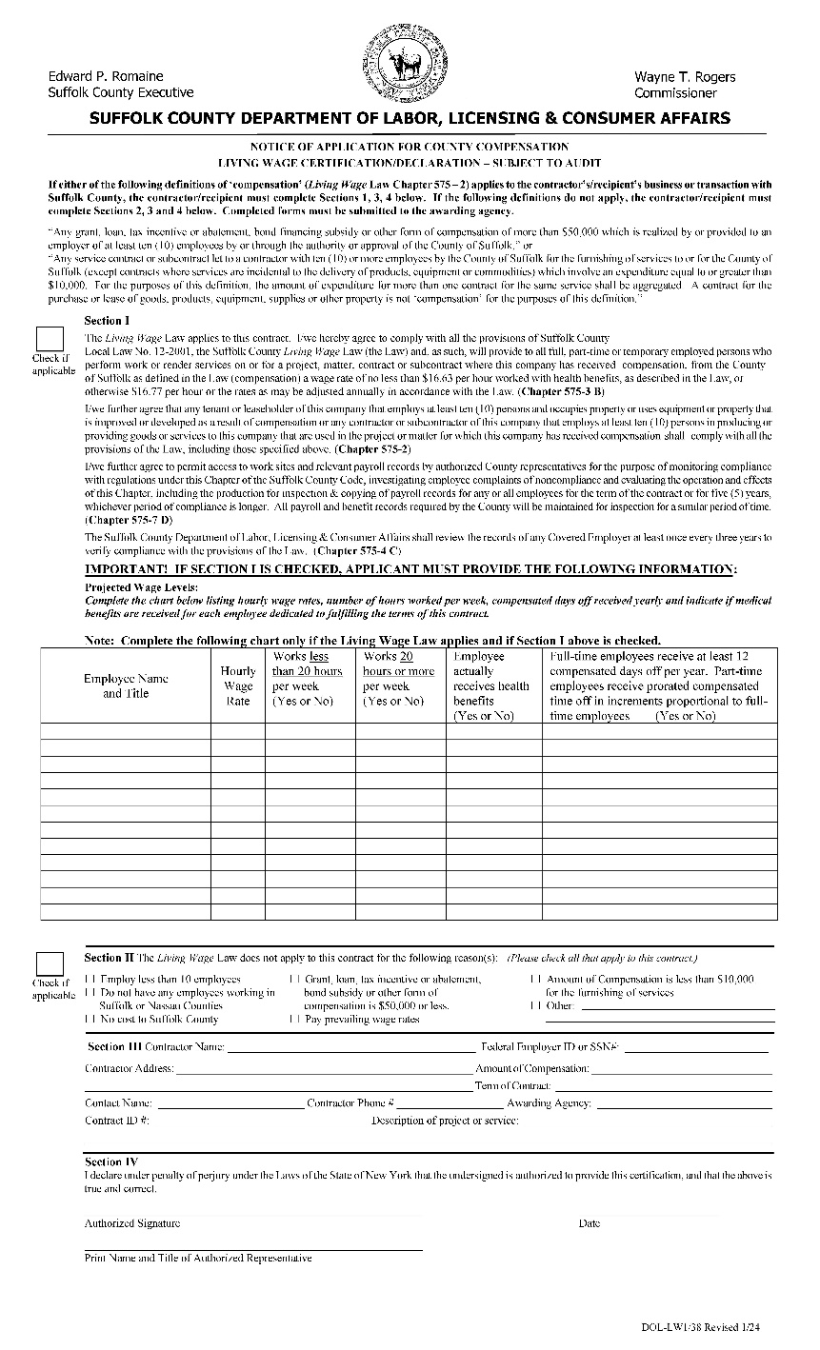
Notes:
LW38 Living Wage Certification with Employees

Slide 20
INSURANCE REQUIREMENTS
Must Submit:
Certificate of Insurance and Policy Declaration Page.
Declaration Page:
1. Two million dollars liability insurance (each occurrence) is required. (Waivers may be requested in writing.)
2. Suffolk County MUST be named as additionally insured
and as the Certificate Holder.
3. Written notice of cancellation.
4. Must show proof of Workers Comp Insurance, if you
have any employees.

Slide 21
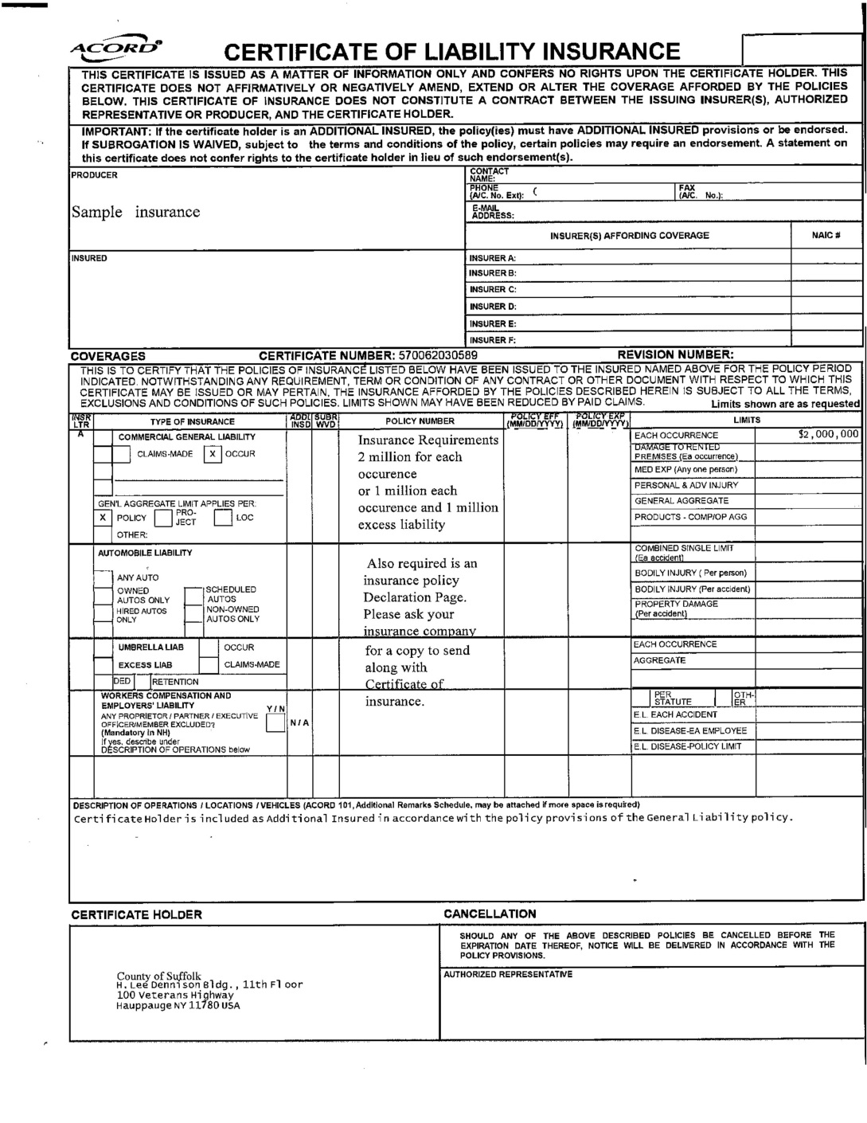

Slide 22
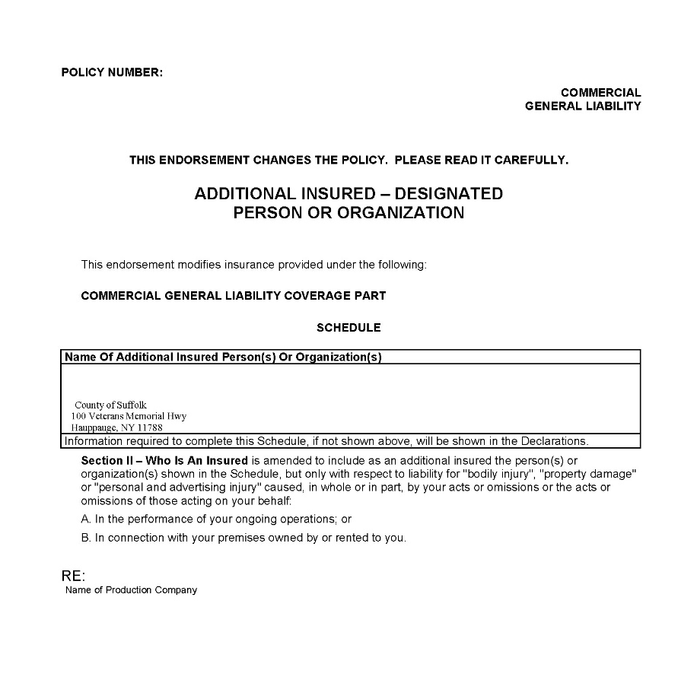

Slide 23
IRS Designation Letter
is Required

Slide 24
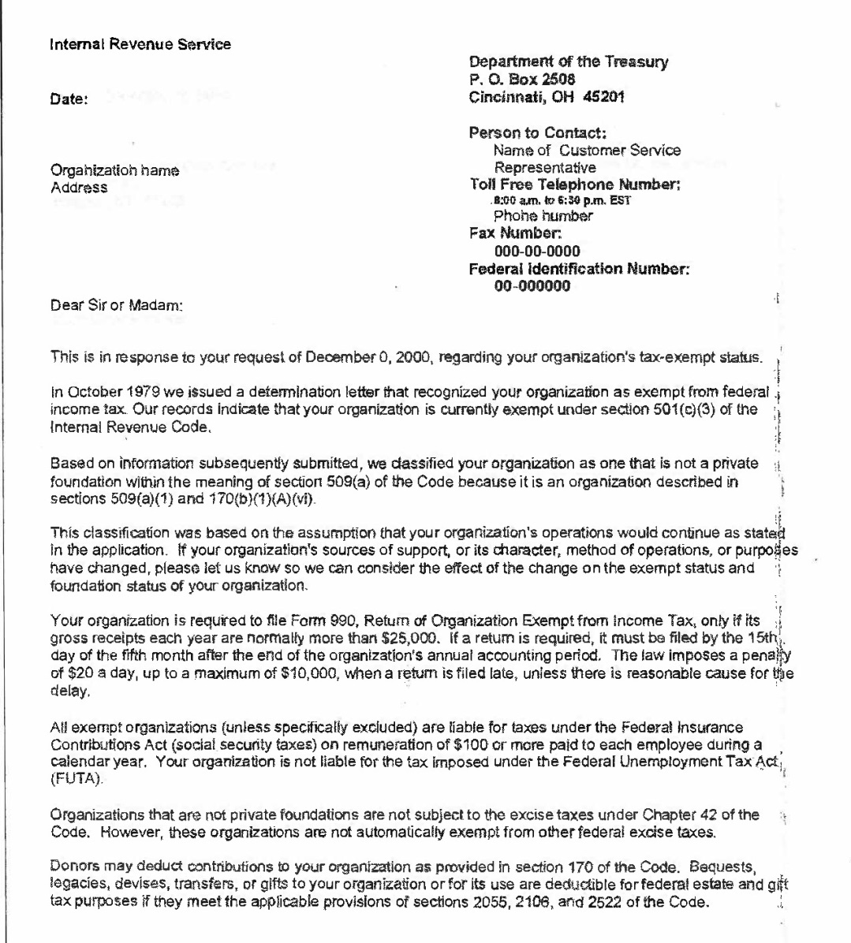

Slide 25
Once you have received your Contracts:
Review, Complete, Sign and Return to our Office:
All 3 copies of the Contract
1 completed and signed packet of Exhibits
Suffolk County Payment Voucher
Statement of Other Contracts
ACH/EFT Enrollment form plus cancelled Check

Slide 26
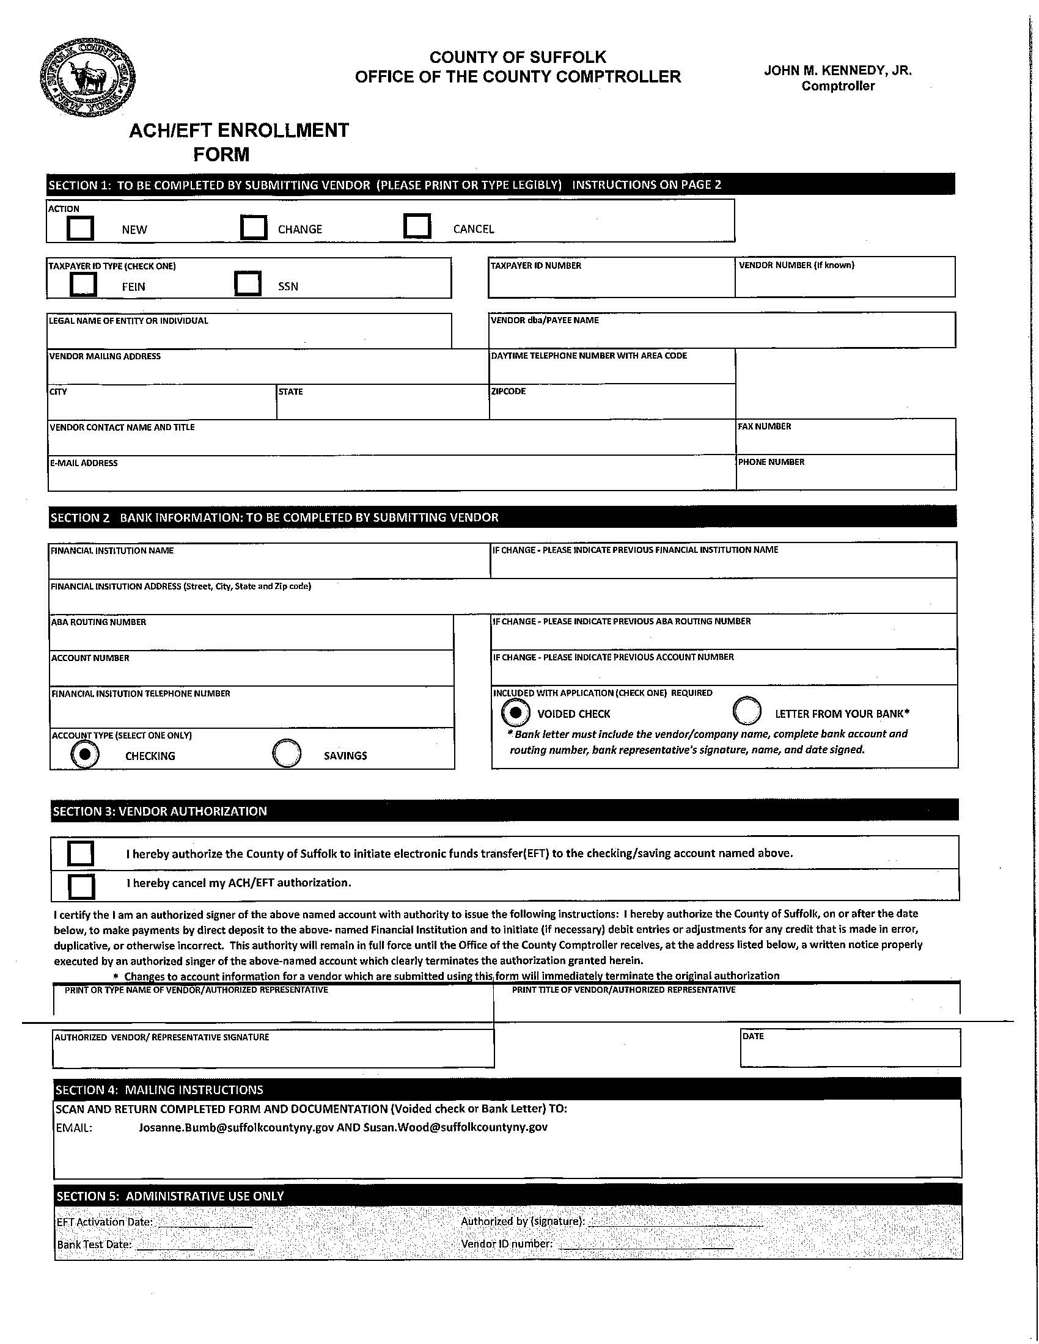

Slide 27
Once Contracts are signed and submitted to the Contracts unit in Economic Development and Planning and are fully executed:
Receive advance payment
Implement Project or Program
Submit receipts and cancelled checks with Summary of Expenditures within 30 days of expenditure or when cancelled checks become available. Budget Modifications must be requested no later than November 15, 2024.
Receipts, invoices or signed contracts from Vendors with their cancelled checks. Submit copies of printed ads or flyers.
Payroll certification letter. For those contracts with approved Program Staff funding, we need payroll record of funded employee showing salary, hours worked, payroll record.
Summary of Expenditures - Expenditures as exactly noted in the Explanation of Costs. Any deviation will create a delay and potential repayment to Suffolk County.
Include a brief summary of your event(s) - how many people attended, financial benefit to the area, significant events (ex. Inclement weather).
Submit receipts. Each expense must be accompanied by an accurate and verifiable invoice from a contracted service or receipt clearly indicating the expense. Put front and back of canceled check on one page. Send only pertinent pages of bank or credit card statements. Please submit receipts in order listed on summary page. Email submission of receipts less than 20 pages. Mail receipts if more than 20 pages. All invoices are subject to verification. Receipts are due 30 days after event - with the exception of year-end events. All receipts are due NO LATER THAN JANUARY 15 of the following year.

Slide 28
PAYMENT INFORMATION:
Contract must be fully executed before payment can be made on a contract.
Grantee must have a signed Suffolk County Payment Voucher.
Processing payment can take up to 4 weeks.

Slide 29
Contract Agency Disclosure Form from
Suffolk County Comptroller’s Office
Deadline is September 15, 2024.
This is an annual Form that must be completed. The Comptroller’s Office will contact all awardees with a unique password and code to access the form.
If not completed by the deadline:
Potentially could lose the funds.
Legislative Resolution required for current year for the payment voucher to be accepted.
Legislative Resolution required for 2025 cycle.

Slide 30
NYS Nonprofit Revitalization Act of 2013
No employee of the nonprofit can serve as the Chair of the Board or hold any other title with similar responsibilities.
All nonprofits must have a Conflict of Interest Policy to ensure that its directors, officers, and key employees act in the nonprofit’s best interest and comply with applicable legal requirements.
Whistleblower Policy required for nonprofits with over 20 or more employees and over $1,000,000 in revenue.
NOTE: There are updates to these laws! Please check NYCON.org or check www.SuffolkArtsandFilm.com

Slide 31
Economic Development & Planning Contacts
Annette Brownell 631-853-4654
annette.brownell@suffolkcountyny.gov
Michele Mueller 631-853-5959
michele.mueller@suffolkcountyny.gov
Diana Cherryholmes 631-853-4834
diana.cherryholmes@suffolkcountyny.gov
jkryjak.011624

